Slide 1
2. NATURAL RESOURCES
LAND RESOURCES
ROLE OF INDIVIDUAL IN CONSERVATION OF RESOURCES

Slide 2
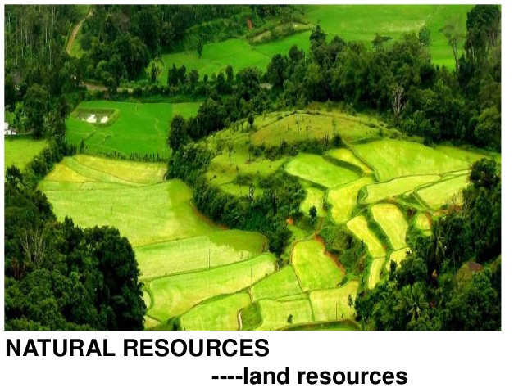
2. NATURAL RESOURCES

Slide 3
f) Land resources:
Land as a resource: Landforms such as hills, valleys, plains, river basins and wetlands include different resource generating areas that the people living in them depend on.
Many traditional farming societies had ways of preserving areas from which they used resources.
Eg. In the ‘sacred groves’ of the Western Ghats, requests to the spirit of the Grove for permission to cut a tree, or extract a resource, were accompanied by simple rituals.

Slide 4
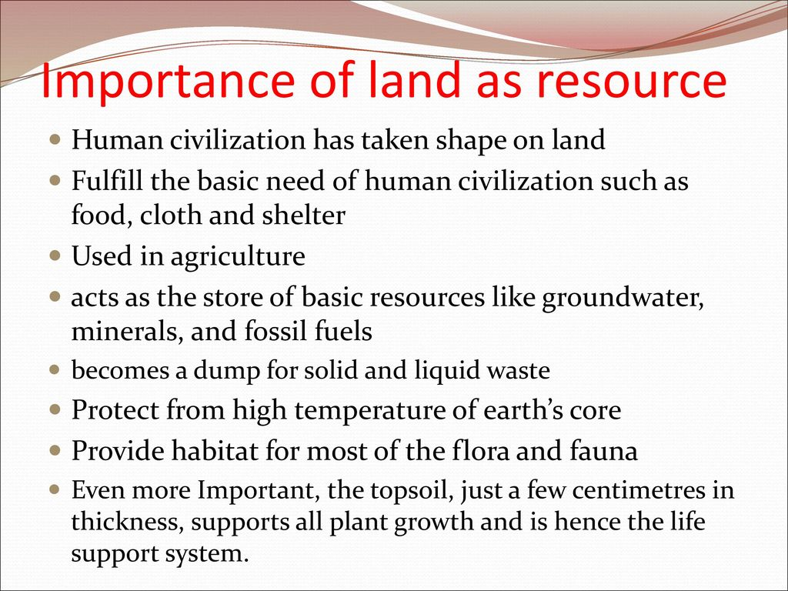

Slide 5
The roots of trees and grasses bind the soil. If forests are depleted, or grasslands overgrazed, the land becomes unproductive and wasteland is formed.
Intensive irrigation leads to water logging and salination, on which crops cannot grow.
Land is also converted into a non-renewable resource when highly toxic industrial and nuclear wastes are dumped on it.

Slide 6
Man needs land for building homes, cultivating food, maintaining pastures for domestic animals, developing industries to provide goods, and supporting the industry by creating towns and cities.
Equally importantly, man needs to protect wilderness area in forests, grasslands, wetlands, mountains, coasts, etc. to protect our vitally valuable biodiversity.

Slide 7
Thus a rational use of land needs careful planning.
One can develop most of these different types of land uses almost anywhere, but Protected Areas (National Park’s and Wildlife Sanctuaries) can only be situated where some of the natural ecosystems are still undisturbed.
These Protected Areas are important aspects of good land use planning.

Slide 8
Land resources- Problems
Land Degradation:
Farmland is under threat due to more and more intense utilisation.
Every year, between 5 to 7 million hectares of land worldwide is added to the existing degraded farmland. When soil is used more intensively by farming, it is eroded more rapidly by wind and rain.
As urban centers grow and industrial expansion occurs, the agricultural land and forests shrink.
This is a serious loss and has long term ill effects on human civilisation.

Slide 9
Soil erosion:
The characteristics of natural ecosystems such as forests and grasslands depend on the type of soil. Soils of various types support a wide variety of crops
The roots of the trees in the forest hold the soil. Deforestation thus leads to rapid soil erosion.
The process is more evident in areas where deforestation has led to erosion on steep hill slopes as in the Himalayas and in the Western Ghats.
These areas are called ‘ecologically sensitive areas’ or ESAs. To prevent the loss of millions of tons of valuable soil every year, it is essential to preserve what remains of our natural forest cover.

Slide 10
2.3 ROLE OF AN INDIVIDUAL IN CONSERVATION OF NATURAL RESOURCES
Biological systems cannot go on replenishing resources if they are overused or misused.
At a critical point, increasing pressure destabilizes their natural balance.
Even biological resources traditionally classified as ‘renewable’ - such as those from our oceans, forests, grasslands and wetlands, are being degraded by overuse and may be permanently destroyed.
And no natural resource is limitless. ‘Non-renewable’ resources will be rapidly exhausted if we continue to use them as intensively as at present.

Slide 11
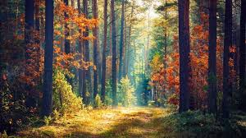
The two most damaging factors leading to the current rapid depletion of all forms of natural resources are :
increasing ‘consumerism’
rapid population growth.
Both factors are the results of choices we make as individuals. As individuals we need to decide;
What will we leave to our children?
(Are we thinking of short-term or long-term gain?)
Is my material gain someone else’s loss?

Slide 12
2.4 EQUITABLE USE OF RESOURCES FOR SUSTAINABLE LIFESTYLES
Reduction of the unsustainable and unequal use of resources, and control of our population growth are essential for the survival of our nation and indeed of human kind everywhere.
Our environment provides us with a variety of goods and services necessary for our day-to-day lives,
A new economic order at the global and at national levels must be based on the ability to distribute benefits of natural resources by sharing them more equally among the countries as well as among communities within countries such as our own.

Slide 13
There are several principles that each of us can adopt to bring about sustainable lifestyles.
This primarily comes from caring for our Mother Earth in all respects.
A love and respect for Nature is the greatest sentiment that helps bring about a feeling for looking at how we use natural resources in a new and sensitive way.

Slide 14
Think of :
the beauty of a wilderness,
a natural forest in all its magnificence,
the expanse of a green grassland,
the clean water of a lake that supports so much life,
the crystal clear water of a hill stream, or
the magnificent power of the oceans, and
we cannot help but support the conservation of nature’s wealth. If we respect this we cannot commit acts that will deplete our life supporting systems.

Slide 15
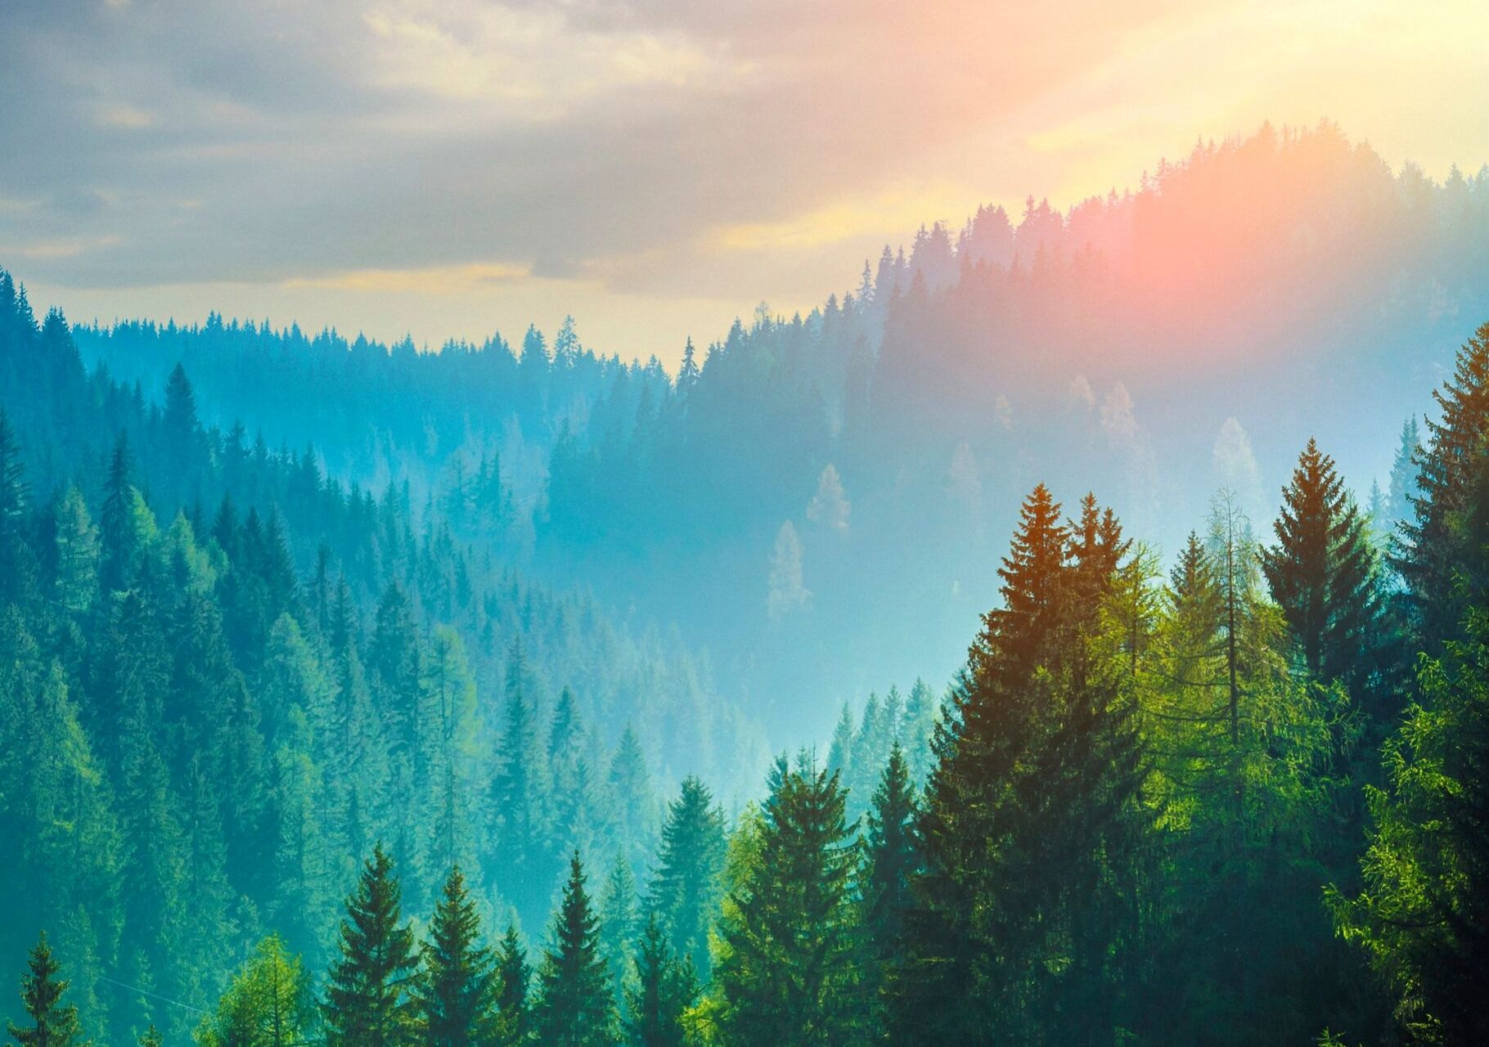

Slide 16
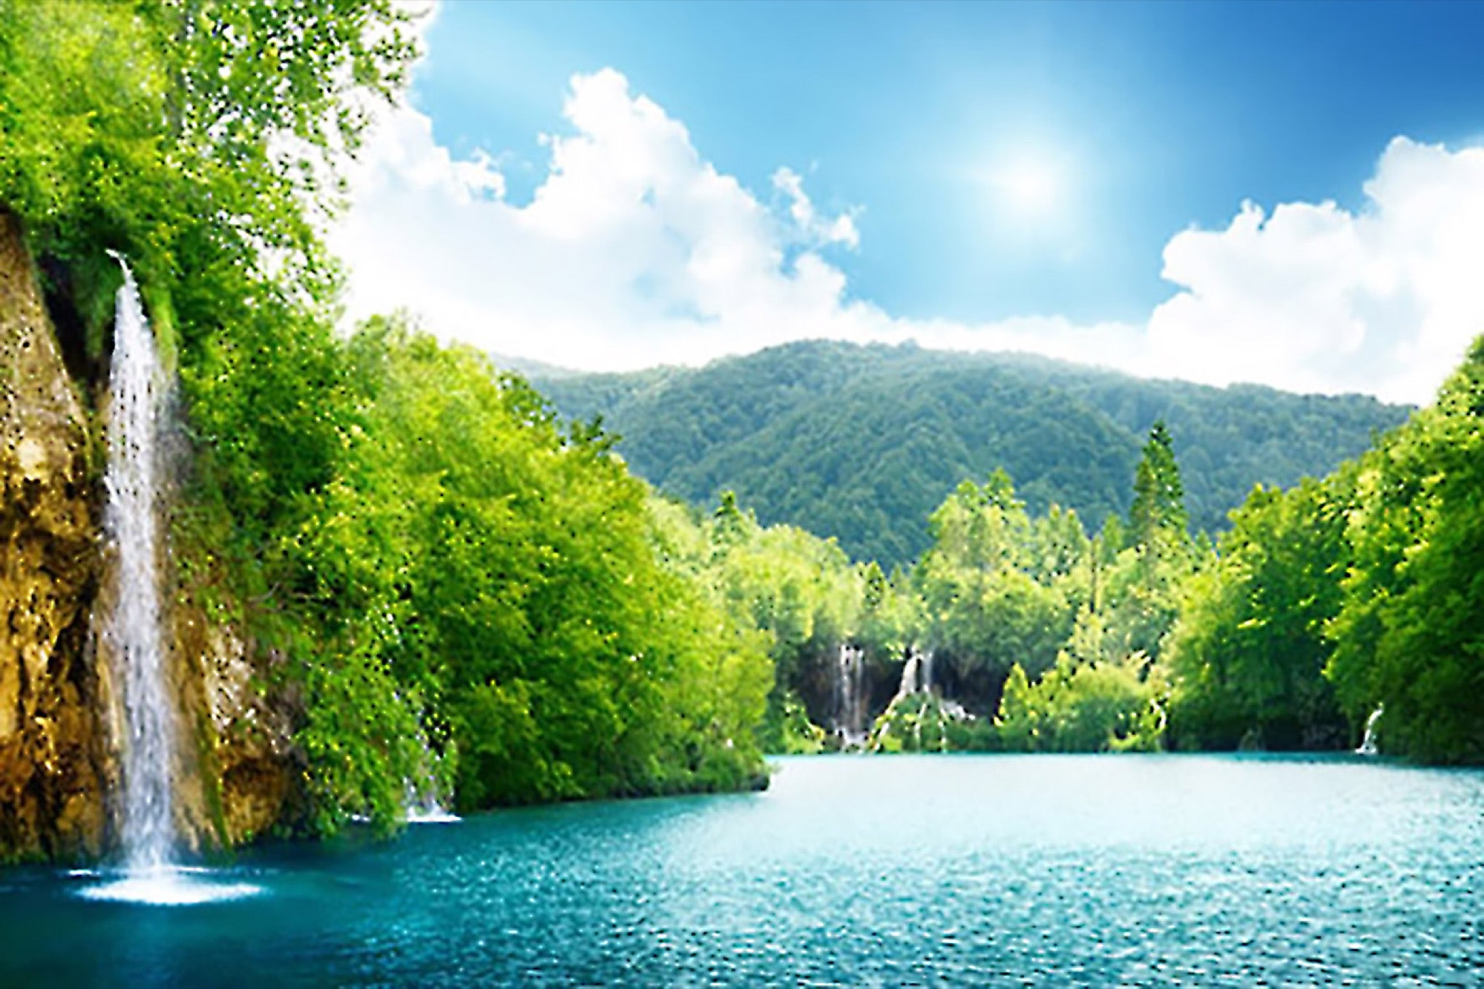

Slide 17
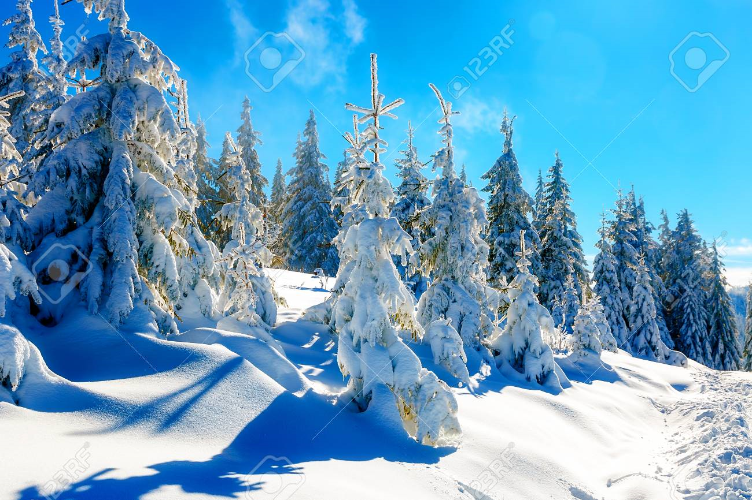

Slide 18
Thank you

